Slide 1
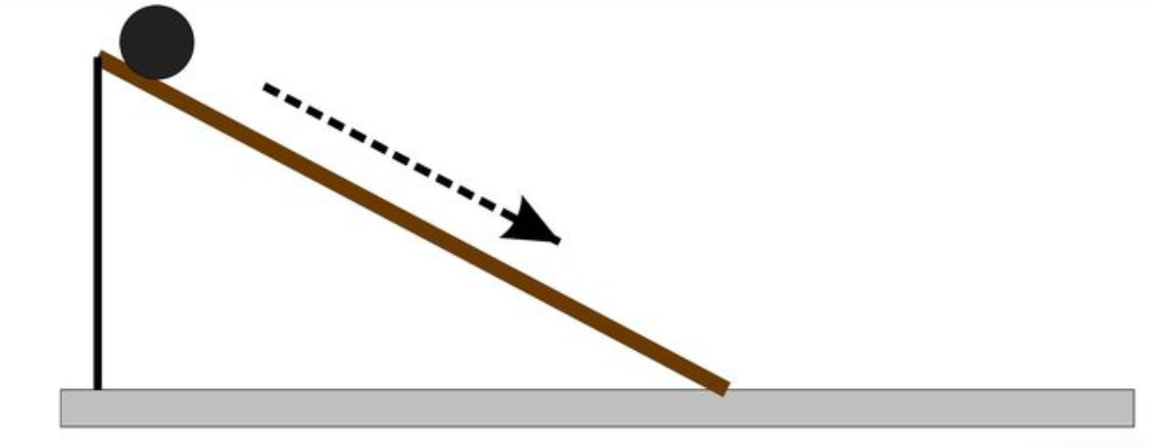
Basic Video Processing
Activity 11
Kenneth M. Leo

Slide 2
What experiments did we do?
With the help of my friends (Ares, Ymman, Liana), we were able to do two different types of experiments. These experiments both measured the acceleration due to gravity g but with different approaches. The first experiment was an inclined plane experiment while the second experiment was a pendulum experiment.
Inclined plane experiment - we used a tennis ball and rolled it in an inclined surface with negligible friction to assume rolling without slipping condition.
Pendulum experiment - we used the same tennis ball and attached it to an almost massless string to allow us to have a simple pendulum.

Slide 3
Materials
Tennis ball
String
Ramp
iPhone (camera: 30 fps)

Slide 4
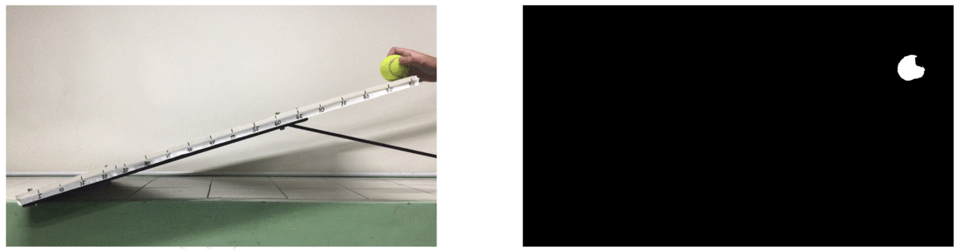
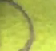

Inclined Plane Experiment
ROI for clear and blurry balls
*I changed the speed of the animation for us to see the motion of the ball

Slide 5
Inclined Plane Experiment
What I did first was create two calibration curves (for x and y) since the ball rolling on an inclined plane has both x and y displacements. Using the calibration curves, I was able to get the actual x and y displacement of the ball. Now using that I can find the velocity on both the x- and y-axes. And after finding the vx and vy, I used Pythagorean theorem to find the velocity of the ball along the direction of the inclined plane. To solve for the acceleration due to gravity I created a plot of the y-displacement of the ball, or h, versus v² based on the equation:
$$v^{2}=\frac{4}{3}gh$$
The equation above is true for rolling without slipping problems.
Source: https://www.khanacademy.org/science/ap-physics-1/ap-torque-angular-momentum/rotational-kinetic-energy-ap/v/rolling-without-slipping-problems?fbclid=IwAR2M0j92XHRniuJO5UFPj6i7ffUhmi-fwXu4HiHHUfePn3GCLtl5Bbunx8M

Slide 6
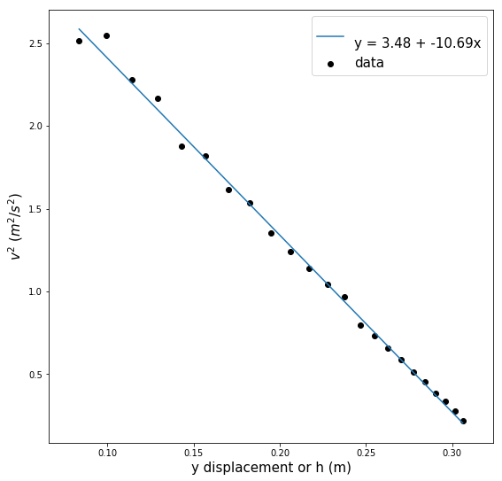
Inclined Plane Experiment
Equating the slope of the fitted curve to $\frac{4}{3}g$, we can now find the experimental value of g which is now equal to -8.018 m/s², which deviated to the theoretical by 18.2%.

Slide 7

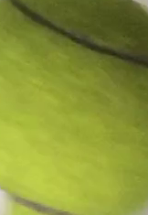
Pendulum Experiment
ROI for both clear and blurry balls
*I changed the speed of the animation for us to see the motion of the ball

Slide 8
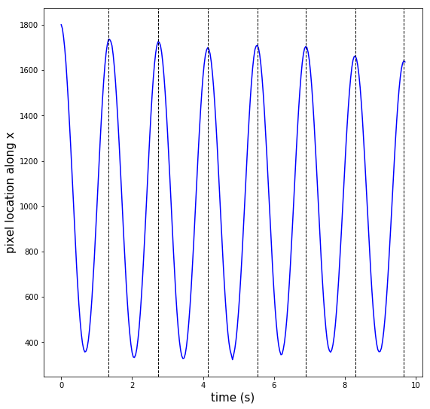
Pendulum Experiment
In this experiment, since we assumed a simple pendulum, I only need to find the average period of the pendulum. I was able to do that by plotting the displacement along the x-axis (which turned out to be a sine wave which is predicted) and searching for the points where the ball reached its original position. Since we already measured the length of the string (0.4765 m), it is now just a matter of plugging the values of Tave (period) of string length (L) to the equation:
$$g=\frac{4π^{2}L}{{T_{ave}}^{2}}=9.75m/s^{2}$$
This value of g has a percent error of just 0.48%!
Tave = 1.39 s

Slide 9
Discussion of results
Comparing the two experiments that we did, I noticed that the pendulum experiment yielded better results. The pendulum experiment is one of the simplest type of physics experiment because you only need a ball and a string. Also, a few post-processing was needed which reduced the probable causes of error. We only looked at the x displacement compared to the inclined plane where we have to look at the both axes. Another reason why the inclined plane experiment did not perform well is we assumed that the plane we used have no friction. The tennis ball that we used was rough so for sure friction is present and possibly not negligible, which could have had an effect on the velocity of the ball.
Score: 12/10 [did 2 experiments and was able to utilize everything learned in class]

